Slide 1

Deep Learning-Based Image Classification on Small and Imbalanced Hyperthyroid SPECT Scan Dataset
Presented by:
Harsh Yadav, Vinay Dagar,
M.Sc. Computer Science
Department of Computer Science, University of Delhi

Slide 2
Outline:
1
2
3
4
5
6
7
Abstract
Introduction
Dataset and Collection
Review of Related Literature
Proposed Work:
Augmentation
Classification
Results and Discussion
Conclusion and Future Work

Slide 3
Abstract
Aim: Solving class imbalance in small-scale datasets for a better generalising diagnostic tool
Problem Statement
Limited annotated medical images create challenges for deep learning
Class imbalance impacts model performance
Overview of Components
Hyperthyroidism Diagnosis using SPECT scans & deep learning
Inherited Imbalance of medical scans
Tackling data imbalance & augmentation challenges
Our Approach
Data Augmentation: Basic techniques, STEM (SMOTE-ENN-MIXUP), GAN-based augmentation, diffusion-based techniques
Model Evaluation: 3-CNN, AlexNet, MobileNetV2, Transfer learning with ResNet50V2
Comparative analysis of all the techniques

Slide 4
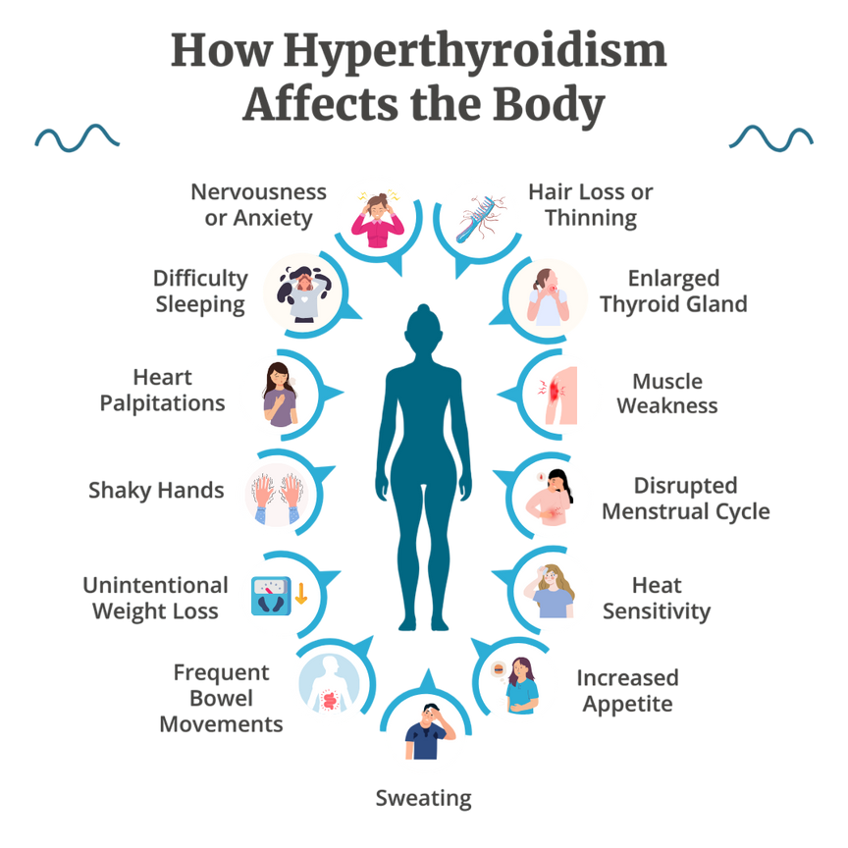
Hyperthyroidism and SPECT scans
What is Hyperthyroidism?
Also known as overactive thyroid, causes over production of thyroid hormone like T3 and T4 in body
About 47 million people in India and 300 million globally []
It is the second largest endocrine disease
Causes of Hyperthyroidism:
Injury near or to the gland
Inherited from family.
Events affecting hormonal balance of body, like pregnancy in women ( also called postpartum thyroiditis)
figure from: Everydayhealth

Slide 5
Hyperthyroidism and SPECT scans
Diagnosis of Hyperthyroidism:
Primary physical examination:
Hyperthyroidism sometimes shows inflammation of thyroid gland as a symptom which is used as primary diagnosis for the doctor to prescribe more specialised tests
Other physical symptoms, like increased heart rate , increased metabolic rate and sudden weight loss are also indicators and used in diagnosis
Blood work: Based on primary diagnosis blood work is prescribed which checks for levels of T3, T4 and TSH hormones
T3 and T4 are higher than normal for Hyperthyroidism
TSH is lower than normal
Medical Imaging: Imaging techniques used are
CT Scan, and Ultrasound
SPECT

Slide 6
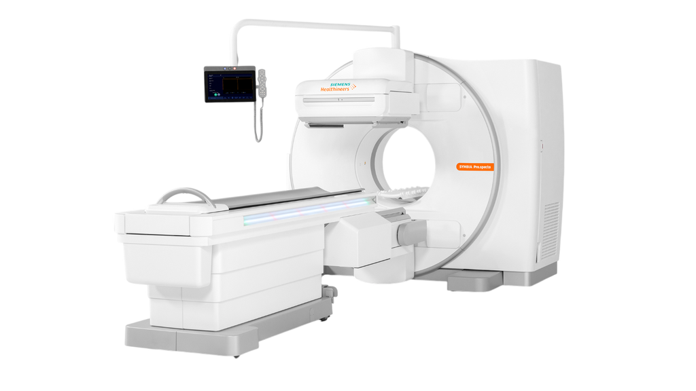
Hyperthyroidism and SPECT scans
SPECT - What and Why:
SPECT - Single Photon Emission Computerised Tomography
Medical Imaging technique that comes under the umbrella of nuclear medicine.
uses a radioactive substance and a gamma camera to create an image of the distribution of this substance within the gland.
preferred in the study over CT or ultrasound for it’s focus on the functionality of the gland over anatomy.
Exposure to radiation is relatively low and acceptable for medical diagnosis. (not recommended for breastfeeding and pregnant women)
Functioning of SPECT:
A radioactive isotope is given to the patient, most commonly Iodine (I-123 or I-131),
to swallow in liquid or capsule form.
The thyroid uptakes this radioactive substance several hours later
Radiations of this substance are captured through the probe of the special camera.
The obtained image is interpreted by a radiologist or a doctor trained in nuclear medicine.
SPECT scanner
Figures from: Siemens healthcare

Slide 7
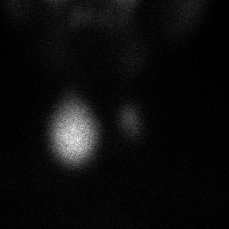
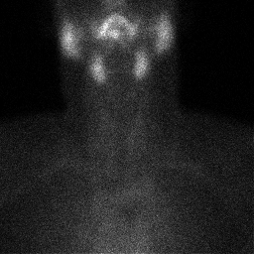
Class selection
Knowing the exact cause behind overproduction of thyroid hormone is crucial in a precise and tailored treatment.
Thus for this study we decided to focus on four most prominent causes:
Autonomously Functioning Thyroid Nodules (AFTN):
characterized by their independent functioning from TSH control.
appear hot in scans because of the greater selective concentration of radionuclide than the rest of the gland
Thyroiditis:
It is a general term that refers to a group of disorders that causes inflammation of the gland. The inflammation often disrupts the gland's normal structure and function.
Autonomously functioning thyroid nodules (AFTN)
Thyroiditis

Slide 8
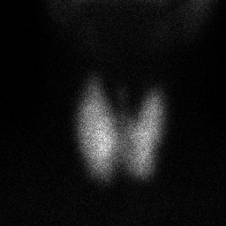
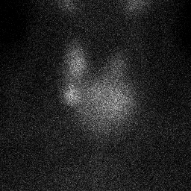
Class selection
3) Diffusely hyper-functioning thyroid glands (Graves disease):
The thyroid gland gets uniformly enlarged in diffusely hyper-functioning thyroid.
Grave’s disease is an autoimmune disorder where antibodies stimulate the TSH receptor, driving thyroid hormone synthesis and glandular growth.
SPECT imaging reveals a homogeneous and increased uptake across the gland.
4) Hyperfunctioning multinodular goitre ( MNG):
It develops from repeated cycles of thyroid cell growth and shrinkage, resulting in an uneven enlargement of the thyroid gland.
This irregularity occurs because different thyroid cells respond differently to external factors like hormones.
Graves disease
Hyperfunctioning multinodular goitre

Slide 9
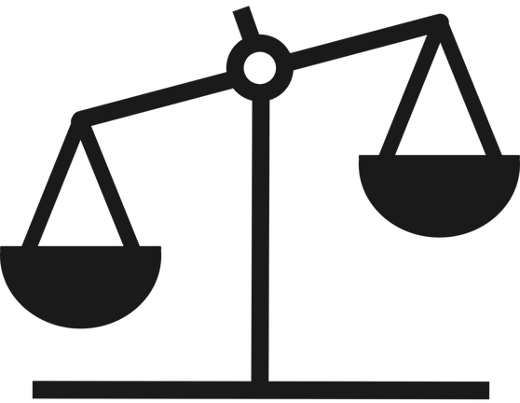
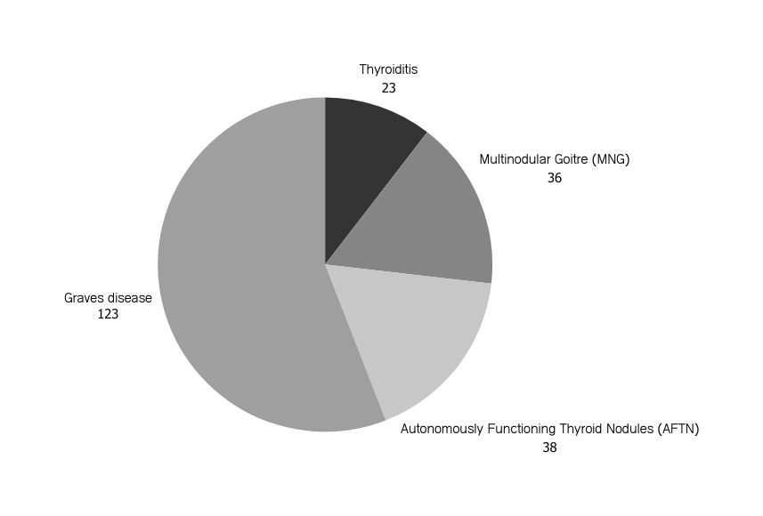
Dataset
The collected raw dataset comprises approximately 325 unlabeled images obtained from various sources.
- Thyroid scan image dataset for the study of thyroid pathologies in adult patients
- GitHub repository (https://github.com/yongpi-scu/TPRNet/tree/main/data)
images lack predefined labels, necessitating a labeling process before further analysis or model training.
The dataset was labeled by experienced radiologists to ensure accuracy and reliability.
Some images contained incorrect scenes and were consequently discarded from the dataset.
The refined dataset consists of 220 labeled scans after the removal of incorrect scenes.
However, the dataset remains highly imbalanced.
The majority class contains 123 images, while the minority classes have between 20 and 40 scans each.

Slide 10
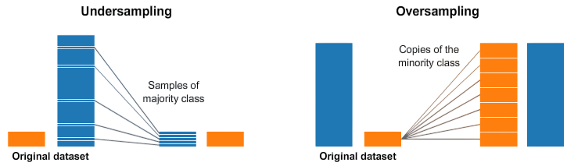
Class Imbalance & Augmentation
Class imbalance, cause, and issues:
It happens when some classes have more or less samples in training dataset than others.
This causes models to be biased towards the majority class, leading to poor generalisation.
Example: In our dataset, Graves Disease has 123 samples, whereas Thyroiditis has only 23.
This happens because of the inherent imbalance in frequency of each type of class in population and the logistics of procuring these scans.
It can be solved by either undersampling the majority class or oversampling the minority class
Mitigating Imbalance with Augmentation
Undersampling wasn’t an option cause of already limited sample space
It would lead to diminished data volume resulting in diminishing performance
Oversampling with Augmentation was the solution, where we increase the samples of Minority classes with various techniques. It can be done to ways:
Transformative Augmentation
Generative Augmentation
figure from: Linkedin

Slide 11

Review of Related Literature

Slide 12
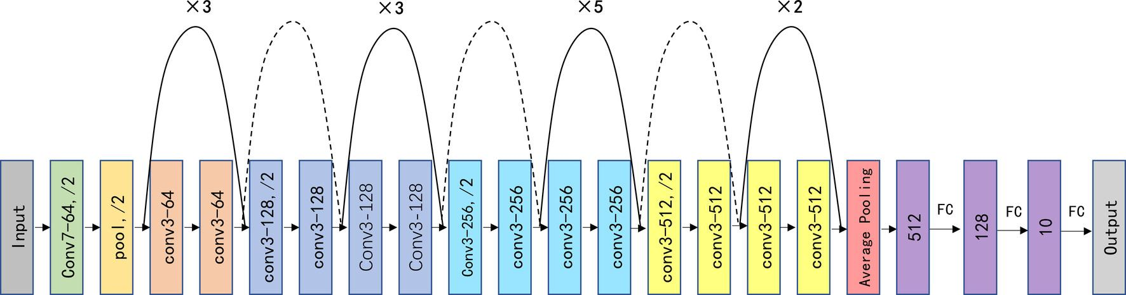
Thyroid disease diagnosis using deep convolutional neural network [11]
Huayi Zhao and his colleagues developed this pipeline.
uses four pre-trained Deep Convolutional Neural Network (DCNN) models, AlexNet, ShuffleNetV2, MobileNetV3, and ResNet-34, to improve the diagnostic performance of nuclear medicine physicians.
The dataset contains 3194 SPECT thyroid images divided into training, internal validation, and external validation and categorized into Graves’ disease, subacute thyroiditis, thyroid tumour, and normal thyroid.
ResNer-34 proved to be the best model. High values (>90) of Recall and precision are achieved.
Their research showed that DCNNs can be used to classify thyroid SPECT images, and the models shows performance better than experienced nuclear medicine physicians.
Conclusion: model is not always perfect. However, it can be a valuable tool for clinicians to make quick and precise diagnoses of thyroid disease in their daily practice.
ResNet-34 model architecture

Slide 13
Deep learning for Intelligent diagnosis in thyroid scintigraphy [12]
Tingting Qia et al. developed a diagnostic assistance system for Nuclear Medicine (NM) Residents using deep learning models such as AlexNet, VGGNet, and ResNet, training each separately with transfer learning on an imbalanced SPECT image dataset.
To address the issue of imbalanced data, the authors generated synthetic samples using Auxiliary Classifier Generative Adversarial Networks (AC-GANs).
They also introduced progressive growth, which started by generating low-resolution images and gradually increased the resolution. This allowed the model to learn pixel features at different scales and produce higher-quality synthetic images.
ResNet emerged as the best-performing model, achieving a Kappa score of 0.802 and proving significant diagnostic assistance. Its inference speeds were 400 to 600 times faster than those of its human counterparts.
Although these models outperformed first-year NM residents, they did not match the diagnostic accuracy of third-year NM residents.
Their study demonstrated that data augmentation and GANs positively impact SPECT scan classification, improving model performance and effectively addressing dataset imbalance.

Slide 14
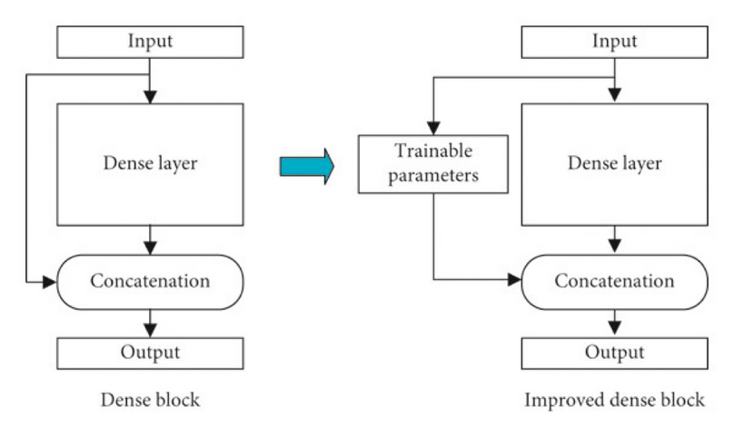
Thyroid Diagnosis Images Using Convolutional Neural Network with Optimization [13]
Liyong Ma and team developed a convolutional neural network
for the optimization-based computer-aided diagnosis of thyroid diseases using SPECT images.
Due to the limited dataset size, Mixup was used to augment the dataset.
A modified DenseNet architecture is employed by adding trainable weight parameters to each skip connection.
improved the training method by optimizing the learning rate with the flower pollination algorithm.
experimental results demonstrated that the accuracy for all classes reached more than 99%.
Their study concluded that augmentation techniques such as Mixup can be effectively used to enhance the dataset and improve the performance of convolutional neural network models in the diagnosis of thyroid diseases using SPECT images.

Slide 15

STEM: SMOTE, ENN, and Mixup Augmentation [14]
Yumnah Hasan developed the STEM method, integrating SMOTE, ENN, and Mixup techniques to address data imbalance in medical imaging.
SMOTE enhances the representation of the minority class by oversampling.
ENN identifies and eliminates instances in the augmented dataset that their nearest neighbors misclassify.
Mixup augmentation is employed after SMOTE-ENN to create new synthetic examples by linearly combining feature vectors and labels of two randomly selected examples from the training dataset.
To address within class imbalance, This method showed better results than existing methods such as ADASYN, Borderline SMOTE, SVM-SMOTE, and SMOTE-Tomek Links.
Tested on two different breast cancer datasets, the method achieved AUC values of more than 0.96 and 0.99.

Slide 16
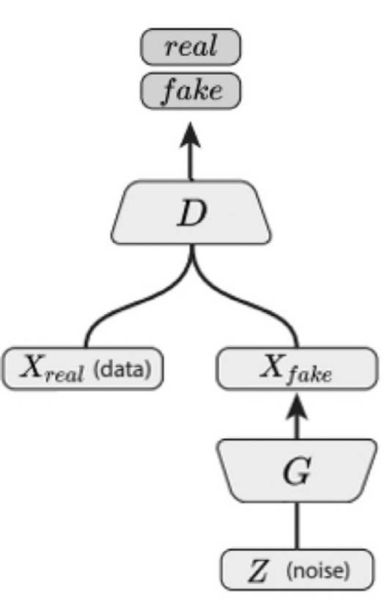
Deep Convolutional GAN (DCGAN) [15]
This method was introduced by Alec Radford & Luke Metz and later successfully reviewed by Maayan Frid-Adar for medical images.
In this method, both Generator G and Discriminator D networks are deep CNNs.
It replaces pooling layers with strided convolutions in the discriminator and fractional-strided convolutions in the generator.
It uses batch normalization in both the generator and the discriminator.
It also removes fully connected hidden layers for deeper architectures.
It also uses ReLU activation in the generator for all layers except the output, which uses tanh.
And uses LeakyReLU activation in the discriminator for all layers.
DCGAN architecture

Slide 17
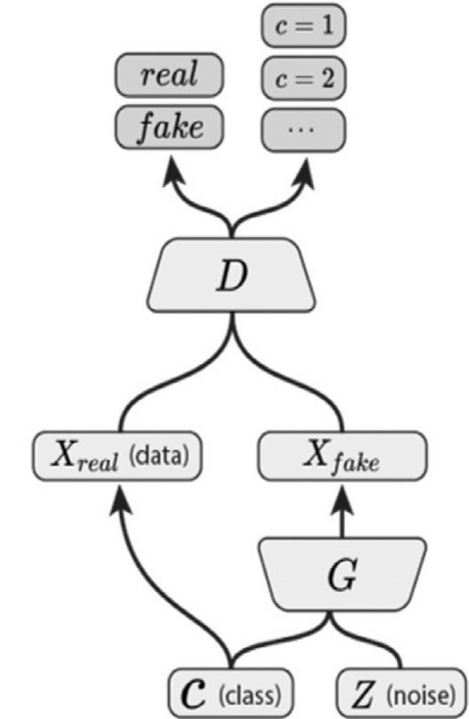
Auxiliary Classifier GAN (AC- GAN) [17]
This method was developed by Augustus Odena, Christopher Olah, and Jonathon Shlens.
In the ACGAN, the generator takes the image class to be generated as input in addition to the latent encoding (Z).
The discriminator outputs both the probability that the input is real and the probability distribution over the class labels.
The generator is trained to maximize the log-likelihood of the correct class and to fool the discriminator.
The discriminator is trained to maximize the log-likelihood of the correct source (real or fake) and the correct class label.
AC-GAN improves the stability of training and the quality of generated images.
It allows for better control over the generated images by conditioning on class labels.
ACGAN architecture
ACGAN architecture
Source: [1

Slide 18
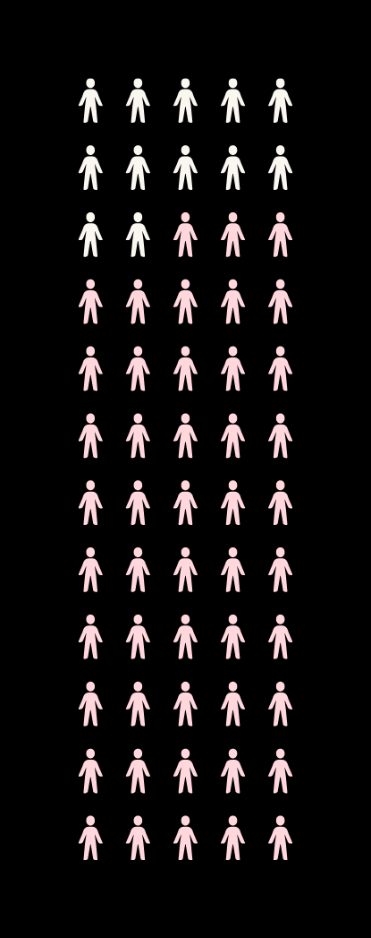
Methodology of Proposed Work

Slide 19
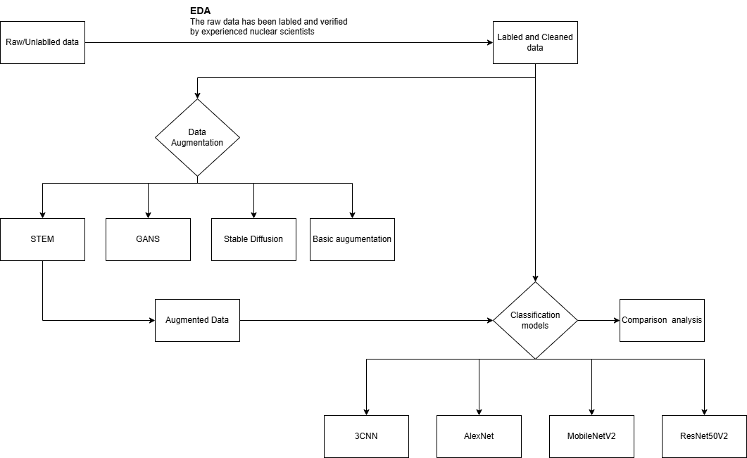
Flow and components

Slide 20
Augmentation Techniques
Basic Transformative Augmentation
STEM( SMOTE, ENN, MIXUP)
GAN(Generative adversarial network) based augmentation
Diffusion based augmentation

Slide 21
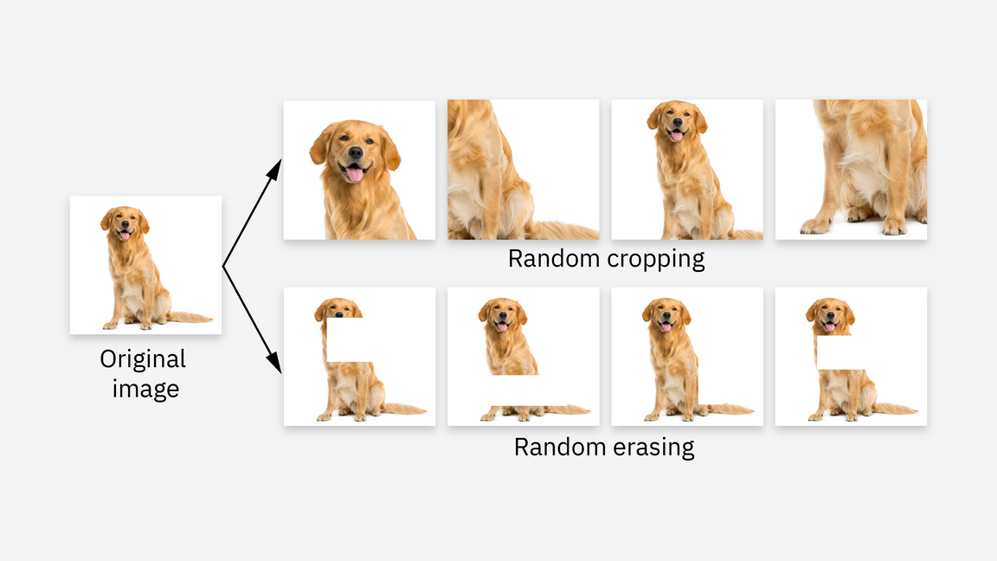
Basic augmentation techniques
Basic Augmentation or Transformative augmentation is a set of standard augmentation techniques, i.e., techniques that transform existing images into a different version by applying operations or filters like flip, zoom, rotate, etc.
We used the following set of operations:
Rescaling: Normalizing pixel values to the range [0, 1].
Rotation Range: Random rotations (up to 40 degrees) to simulate changes in image angle.
Width and Height Shifts: Random horizontal and vertical shifts (up to 20%) to account for slight misalignments.
Shear Range: Applying random shear transformations to simulate perspective changes.
Zoom Range: Random zoom to handle variations in scale.
Horizontal Flip: Flipping images horizontally to avoid orientation bias.
Fill Mode: Using the 'nearest' method to fill empty pixels after transformations.
Transformative techniques provide a new perspective on existing data.
However, it doesn’t help much with data diversity, especially in the case of function-dependent scans such as SPECT, as it doesn't add any “new” scans to the dataset.
figure from: IBM

Slide 22
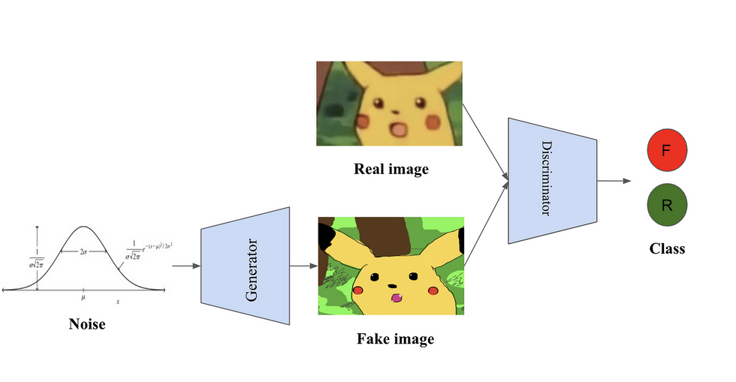
Generative Augmentation
Another approach towards augmenting datasets is “generating” new images using state-of-the-art AI models.
Generative AI creates new images from noise
They do so by learning patterns from already existing data
This newly generated data helps improve data diversity and train better generalizing models which can predict never-before-seen images better.
Concerns with generative AI:
Image fidelity: By far the biggest concern is how close to the real generated images are, especially in clinical applications
figure from: Medium
High Resource Requirement: Generative AI is compute-heavy and requires a lot of computational strength and prerequisite data to train upon
Its application on small-scale data for augmentation is a major focus of this study,
We worked with some major techniques like STEM, ACGAN, DCGAN, and Stable Diffusion

Slide 23
STEM
Results
The raw dataset contains 220 images divided into four classes containing 123, 36, 38, and 23 samples, respectively.
Initially the code was set for 30 epochs with an early stopping condition of generation of at least 5 images.
First SMOTE and ENN were applied on the images to tackle the between class imbalance problem.
Starting with 220 samples, the code terminates after the second epoch due to the early stopping condition as it fails to generate new samples further
Then mixup has been applied and a total of 640 samples were generated.
The algorithm was set to use only two neighbours for image generation because of fewer data samples available.
Although the target imbalance ratio has been set to 0.7 for the dataset, the final result is less than 0.5.
STEM: SMOTE (Synthetic Minority Over-sampling Technique)-ENN and Mixup Results
 | Total Classes |  |  |  | Total Images | Net Increase | Imbalance Ratio
 | AFTN | Graves | MNG | Thyroi- -ditis
Initial | 36 | 123 | 38 | 23 | 220 | - | 0.187
Iteration 1 | 120 | 76 | 121 | 122 | 439 | 219 | 0.623
Iteration 2 | 123 | 59 | 123 | 123 | 428 | -11 (<5) | 0.6
Iteration stops as the total number of images decreases, and the net increase in the number of images is below the desired, at least 5 new samples.
Mix up | 184 | 88 | 184 | 184 | 640 | 420 | 0.478

Slide 24
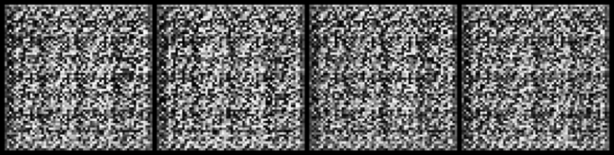
GAN: Generative Adversarial Network
This study implemented two GAN models for augmentation: ACGAN and DCGAN.
DCGAN:
The generator uses several deconvolutional (fractional-strided convolution) layers.
Each deconvolutional layer is followed by batch normalization and ReLU activation, except for the output layer, which uses tanh activation.
The discriminator uses several convolutional layers.
Each convolutional layer is followed by batch normalization and LeakyReLU activation.
The Adam optimizer is used for both the generator and the discriminator.
Images generated by DCGAN

Slide 25
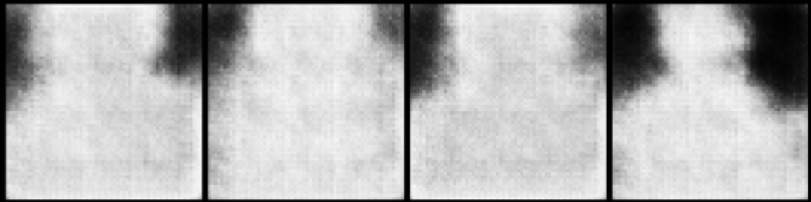
GAN: Generative Adversarial Network
AC-GAN:
The generator takes a latent vector (Z) and a class label as input.
The generator uses several deconvolutional (fractional-strided convolution) layers.
Each deconvolutional layer is followed by batch normalization and ReLU activation, except for the output layer, which uses tanh activation.
The discriminator takes an image and outputs both the probability that the image is real and the probability distribution over the class labels.
The discriminator uses several convolutional layers.
Each convolutional layer is followed by batch normalization and LeakyReLU activation.
The discriminator’s final layer uses a sigmoid activation for real/fake classification and a softmax activation for class label prediction.
The Adam optimizer is used for both the generator and the discriminator.
Images generated by ACGAN

Slide 26
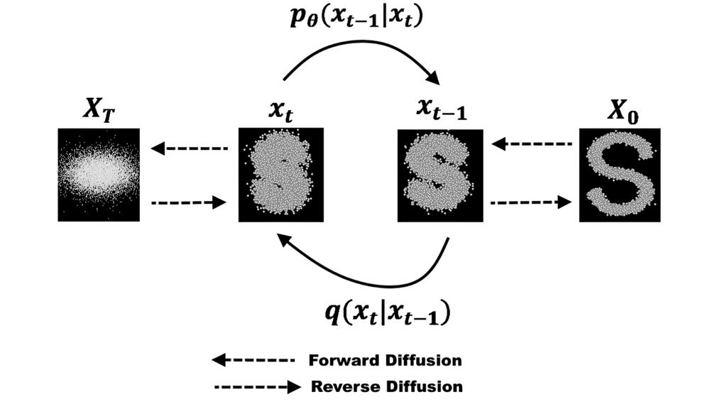
Diffusion based Augmentation
Diffusion-based generative AI is the latest addition to the field and the trendiest one so far.
They are most commonly used in prompt-to-image or text-to-image generation scenarios
They work on the principle of physical diffusion
Some well-known diffusion-based models are DALLE by OpenAi, StableDiffusion, and Midjourney
Functioning:
During training, the model randomly adds noise to the image iteratively ( forward diffusion)
This noise is added until the image becomes unrecognizable
Follows a Markov chain in iterations
Each state is only dependent on the previous state
Learns this Markov chain
Creates a Latent space full of the relations between prompts and Markov chains for each training record
Uses this latent space and learned patterns to produce a new image
Problems:
Computationally expensive
Hallucinations
figure from: Medium

Slide 27
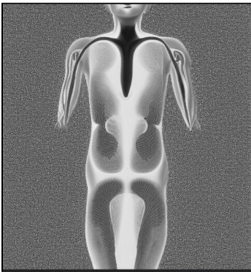
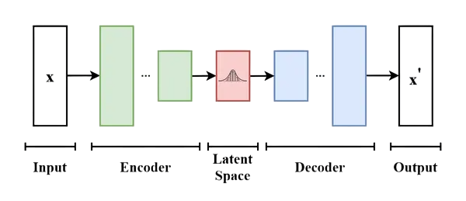
Stable Diffusion
For this study, we implemented Stable diffusion of OpenAI
It is a deep learning-based, latent diffusion model that is used for
Text-to-Image synthesis
Image-to-Image synthesis
The diffusers library of the Pytorch framework was utilized to build and train the model
DPMSolverMultistepScheduler was used for the diffusion process
A pre-trained version of stable diffusion CompVis/stable-diffusion-v1-4 from the library was used
Results
We encountered severe hallucinations from the model which can be caused by limited sample space
Visual fidelity:
The generated results were found to be not even of human anatomy let apart comparable to SPECT scans of thyroid
Generated image
figure from: Analyticsvidhya.com

Slide 28
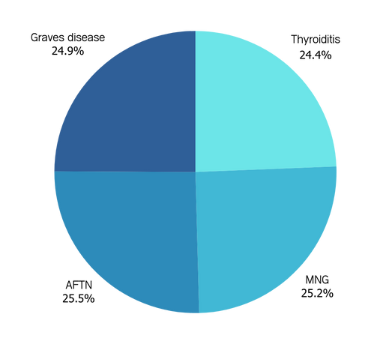
Final results and selection of Augmented data
After a careful Comparative Analysis of All the results based on Visual fidelity to the original data and Clinical accuracy of generated scans, STEM was chosen as the choice of augmentation.
After Augmentation our final dataset looked like:
Before Undersampling
After Undersampling
Class Name | Number of Instances
Thyroiditis (class 0) | 88
Multinodular Goitre (MNG) (class 1) | 91
Autonomously Functioning Thyroid Nodules (AFTN) (class 2) | 92
Graves disease (class 3) | 90
Class Name | Number of Instances
Thyroiditis (class 0) | 88
Multinodular Goitre (MNG) (class 1) | 91
Autonomously Functioning Thyroid Nodules (AFTN) (class 2) | 92
Graves disease (class 3) | 90
Visualisation of Balanced Data

Slide 29
Classification models
3-CNN
AlexNet
MobileNetV2
ResNet50V2 ( Transfer Learning)

Slide 30
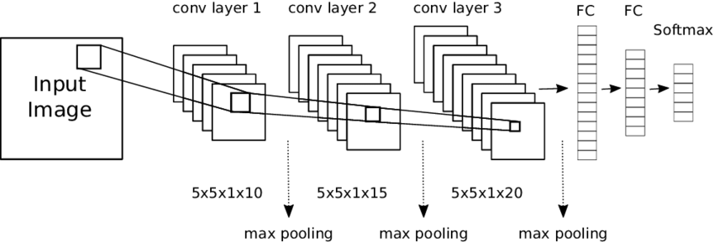
3-CNN
3-CNN is a 3-layer Convolutional Neural Network, a lightweight deep learning architecture designed for small datasets, balancing performance and computational efficiency.
It consists of
three convolutional layers, followed by
activation functions (ReLU),
batch normalization,
max-pooling
to reduce spatial dimensions while retaining key features.
The final layers include
fully connected (dense) layers [ReLU activation]
a softmax output layer, enabling multi-class classification.
3-CNN is particularly useful for small and imbalanced datasets as it prevents overfitting while extracting essential spatial features from medical images.
Compared to deeper networks, a 3-layer CNN is computationally less expensive, making it suitable for medical applications where data is limited.
figure from: Researchgate.com

Slide 31
3-CNN
Here are the details of the architecture:
Input Layer: Takes an image with the shape defined by the input_shape parameter.
Convolutional Layers:
First block: 32 filters, 3x3 kernel size, ReLU activation.
Second block: 64 filters, 3x3 kernel size, ReLU activation.
Third block: 128 filters, 3x3 kernel size, ReLU activation.
Max-Pooling Layers: After each convolutional layer, max-pooling with a 2x2 pool size is applied to downsample the feature maps.
Flatten Layer: Flattens the 3D feature maps into 1D vectors to feed into fully connected layers.
Fully Connected (Dense) Layers:
First dense layer with 128 units and ReLU activation.
Dropout layer with a rate of 0.5 to reduce overfitting.
Second dense layer with 64 units and ReLU activation.
Output Layer: A softmax activation is used in the output layer for multi-class classification, where the number of units corresponds to the number of classes in the dataset (num_classes).
The model is compiled using the Adam optimizer, with categorical cross-entropy as the loss function.

Slide 32
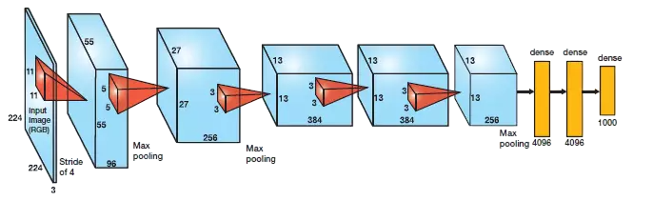
AlexNet
AlexNet is a deep convolutional neural network (CNN) architecture that revolutionized deep learning by winning the ImageNet competition in 2012.
It consists of 8 layers:
5 convolutional layers for feature extraction.
3 fully connected (FC) layers for classification.
Uses ReLU (Rectified Linear Unit) activation, speeding up training compared to traditional activations like sigmoid/tanh.
Overlapping Max-Pooling reduces spatial dimensions while retaining important features.
Dropout Regularization in fully connected layers reduces overfitting
Despite being an older architecture, AlexNet remains relevant due to its strong feature extraction capabilities.
Compared to 3-layer CNNs, AlexNet captures more complex spatial relationships in images
AlexNet was further modified to fit the requirements
figure from: CV-tricks.com

Slide 33
AlexNet
The model consists of the following key components:
Convolutional Layers:
The first convolutional layer uses 64 filters with an 11x11 kernel and a stride of 4 to capture low-level features like edges and textures.
The subsequent layers use 5x5 and 3x3 kernels with ReLU activation, progressively learning more abstract features. The number of filters increases from 192 to 256.
Max-Pooling Layers:
Max-pooling layers with 3x3 windows and a stride of 2 are used to downsample the feature maps, retaining important features while reducing the spatial dimensions.
Flattening Layer:
After the convolutional and pooling layers, the feature maps are flattened into a one-dimensional vector to be fed into the fully connected layers.
Fully Connected Layers:
Two fully connected layers with 4096 units each, using ReLU activation, help combine the learned features for classification.
Dropout Layers:
To prevent overfitting, dropout with a rate of 0.5 is applied to the fully connected layers, randomly deactivating neurons during training.
Output Layer:
The output layer uses softmax activation for multi-class classification.

Slide 34
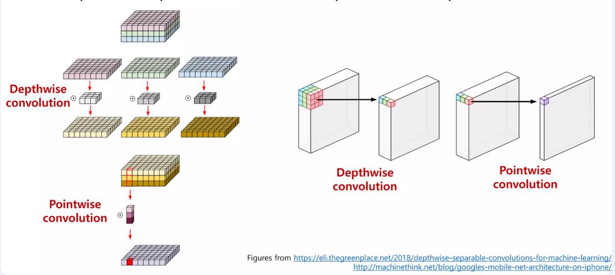
MobileNetV2
It was designed by Google for efficient deep learning on mobile and embedded devices.
Compared to traditional CNNs like AlexNet and ResNet, MobileNetV2 has fewer parameters, making it suitable for small datasets
MobileNetV2 is more suitable for real-time processing on devices with limited computational power while still providing sufficient expressiveness for classification tasks.
Key Features of MobileNetV2:
Depthwise Separable Convolutions:
splits the standard convolution process into two separate operations:
depthwise convolutions (which apply a single filter to each input channel)
pointwise convolutions (which combine the results).
Reducing the number of parameters, making model lightweight and efficient.

Slide 35
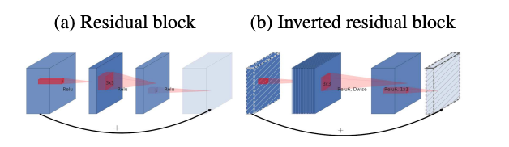
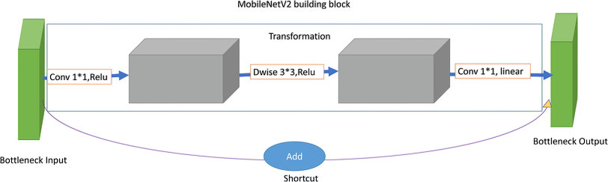
MobileNetV2
Key Features Continued
Inverted Residuals blocks:
A lightweight convolution is used to expand the input, followed by a pointwise convolution that reduces the dimensionality.
This ensures that computational resources are used effectively and allows for better performance with fewer parameters.
Linear Bottleneck:
after processing features in a compressed space, it restores them without applying ReLU at the end.
helps retain more information, improving the network’s ability to capture fine-grained details
figure from: Researchgate.com

Slide 36
MobileNetV2
MobileNetV2 was adapted to handle small medical datasets effectively. The architecture used in this model consists of the following layers:
Base Model (MobileNetV2):
The pre-trained MobileNetV2 model is utilized as the base feature extractor.
Modification: Instead of using the top layer of MobileNetV2 (which is designed for large datasets and general purposes), the top is excluded (include_top=False), and the focus is shifted to using the convolutional feature extraction capabilities.
Flatten Layer:
After extracting the features, the output is flattened into a one-dimensional vector to be passed to the fully connected layers for classification.
Fully Connected Layer:
A dense layer with 128 neurons and ReLU activation is used to combine the features and learn complex patterns. The dropout rate of 0.5 is applied to prevent overfitting, especially given the small dataset size.
Output Layer:
The final output layer uses softmax activation, allowing the model to classify the input into multiple Classes

Slide 37
Transfer learning with ResNet50 V2
ResNet50V2 is a deep convolutional neural network (CNN) designed for image classification
Known for its use of residual connections to improve training stability and gradient flow.
It consists of 50 layers and uses residual blocks that help mitigate the vanishing gradient problem, allowing deeper networks to train effectively.
In a transfer learning approach, we use a ResNet50V2 model pre-trained on large datasets (e.g., ImageNet) and fine-tune it on our smaller, domain-specific dataset of thyroid SPECT scans.
Pre-trained network’s learned features have already captured low-level and high-level patterns useful for image classification.
Early convolutional layers of ResNet50V2 capture generic features such as edges and textures
Later layers focus on complex structures
We trained our model with gradual unfreezing :
This approach significantly reduces training time, improves accuracy, and helps the model generalize better
Phase 1: The base ResNet50V2 model was frozen during the first phase of training
to prevent altering the general features learned on ImageNet.
only the custom top layers were trained, learning rate of 1e−4.
Phase 2: Fine-tune the last 30 layers of the ResNet50V2 base model with a reduced learning rate of 1e−5.

Slide 38
Transfer learning with ResNet50 V2
Architecture for Transfer Learning:
The model is built by leveraging the pre-trained ResNet50V2 model as the base feature extractor. The pre-trained weights from ImageNet are used, and the model is then customised for the specific classification task at hand (in this case, the medical imaging dataset).
Base Model (ResNet50V2):
Pre-trained Weights: The base model uses weights pre-trained on ImageNet, allowing the model to capture general features like edges, textures, and shapes applicable to a wide range of images.
Include Top=False: The final classification layer from the ResNet50V2 model is excluded (include_top=False). Instead, classification layers tailored to the medical dataset were used.
Freezing the Base Model:
Base Model Freezing: To preserve the knowledge from ImageNet, the base ResNet50V2 model is frozen (base_model.trainable = False), meaning that its weights will not be updated during training. This is common in transfer learning to prevent overfitting on smaller datasets.
Grayscale to RGB Conversion:
SPECT scans are grayscale, the input images are converted to RGB by repeating the single channel across three channels using a Lambda layer. This is necessary because ResNet50V2 expects RGB images as input.

Slide 39
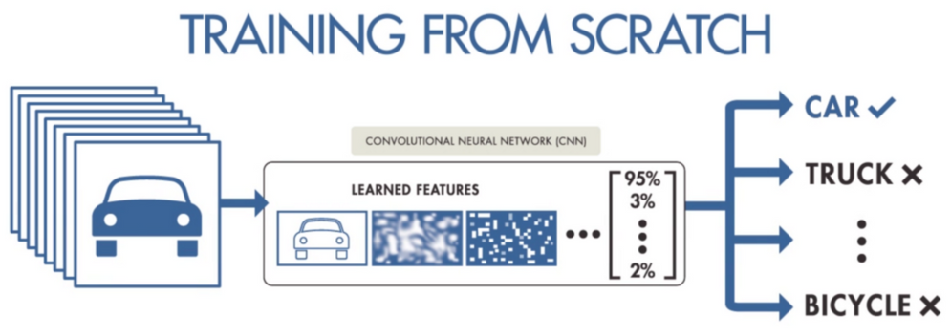
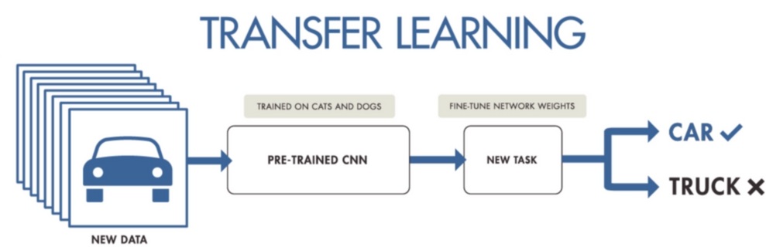
Transfer learning with ResNet50 V2
Architecture for Transfer Learning:
Custom Layers:
GlobalAveragePooling2D: After passing the image through the pre-trained model, the output is subjected to global average pooling, which reduces the spatial dimensions and converts the 3D tensor into a 1D vector, summarizing the spatial information.
Dropout: Dropout layers with a rate of 0.5 are added to prevent overfitting, especially given the smaller dataset.
Dense Layer: A fully connected layer with 256 neurons and ReLU activation is added
Output Layer: The final output layer uses the softmax activation function to classify the input into multiple classes
figure from: Linkedin

Slide 40
Results

Slide 41
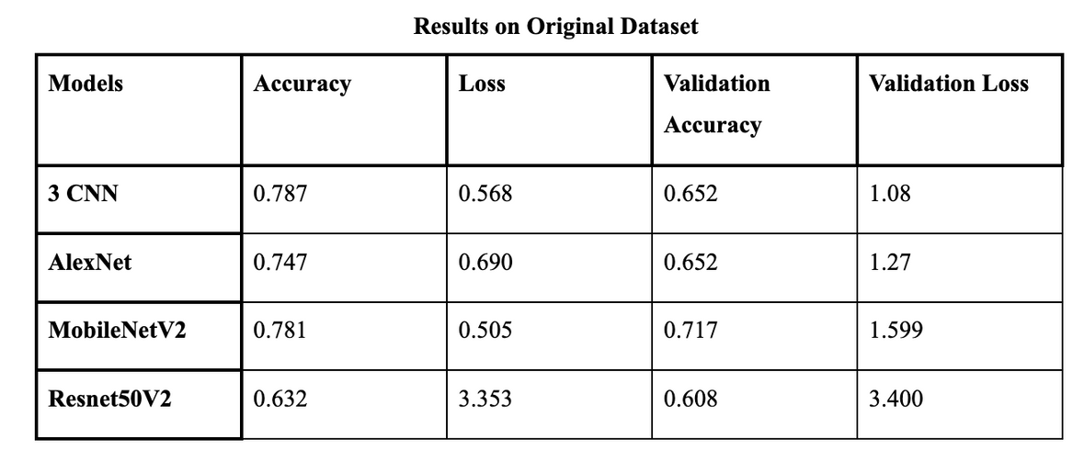
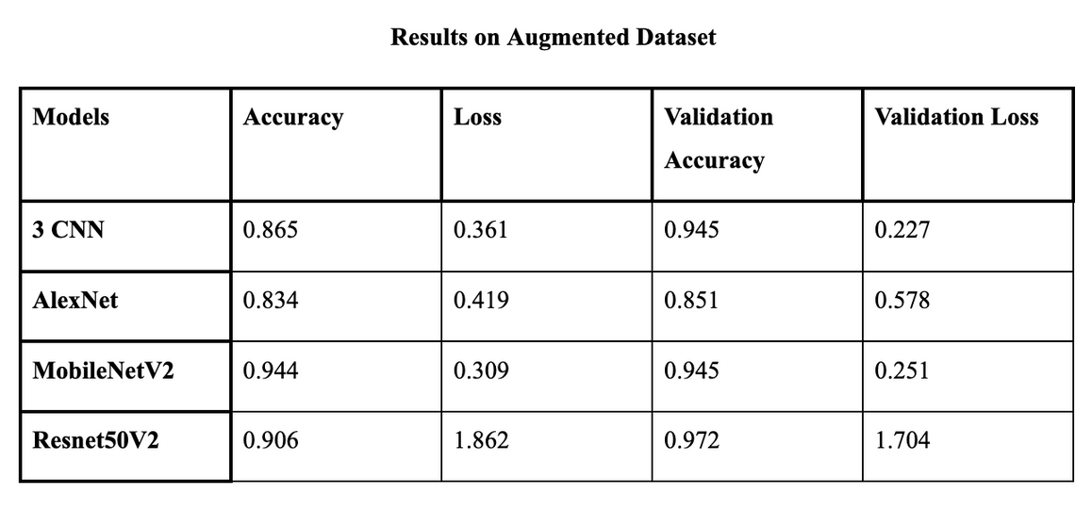
Accuracy

Slide 42
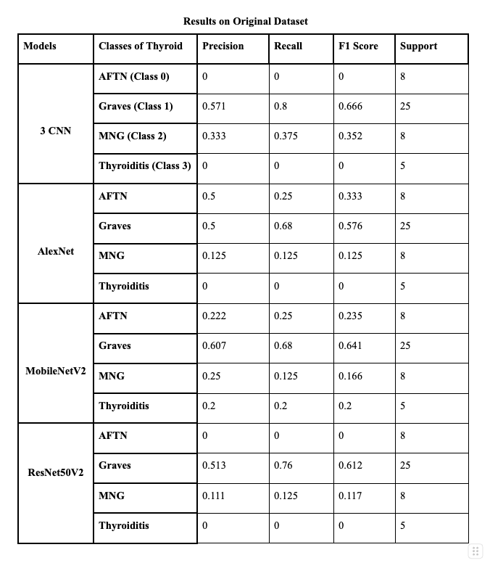
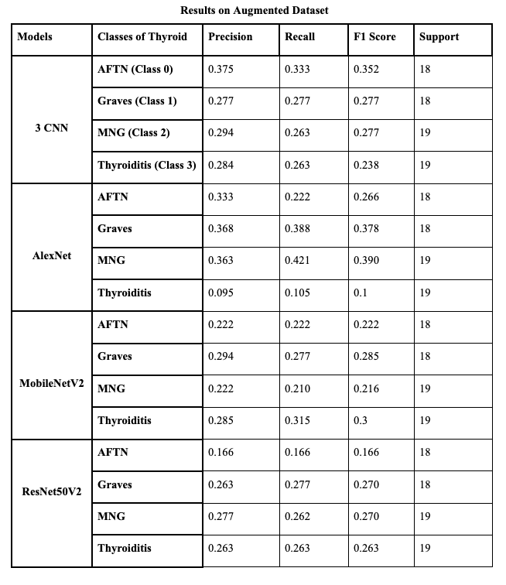
Precision and Recall

Slide 43
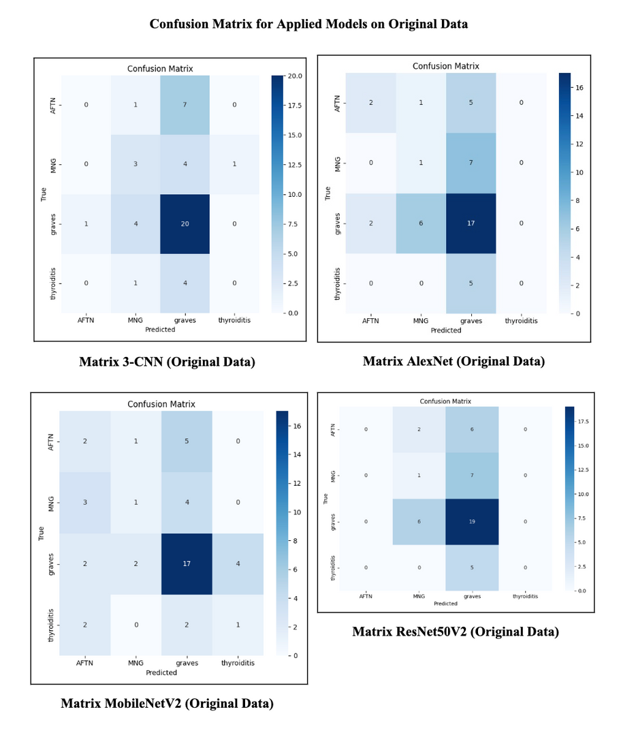
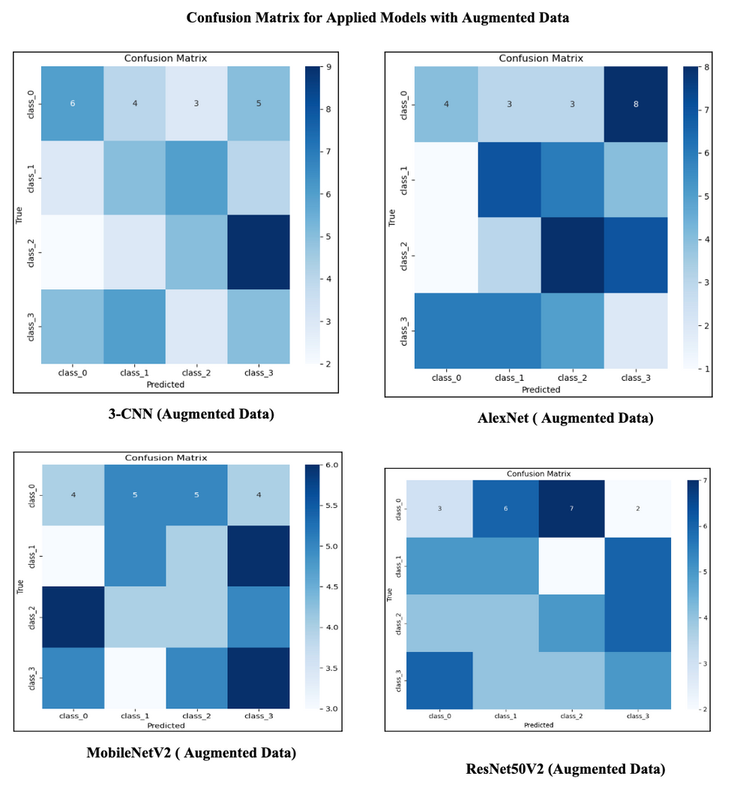
Confusion matrix

Slide 44
Conclusion
This study addressed the challenge of classifying hyperthyroid conditions from SPECT images, focusing on handling small and imbalanced datasets.
implemented various data augmentation techniques, including SMOTE, GANs, and Stable Diffusion, to improve dataset balance and model performance.
Four deep learning models (3-CNN, AlexNet, MobileNetV2, and ResNet50V2) were evaluated to determine the most effective classification approach.
"MobileNetV2 achieved the highest accuracy (94.4%), proving to be the most efficient model for this task.
results indicate that augmentation increased model generalization throughout
provides a foundation for further exploration of deep learning in medical image classification, with potential real-world applications in automated hyperthyroid diagnosis.

Slide 45
Future Works
Dataset Expansion
Incorporate more diverse SPECT scan images from multiple medical sources to improve model generalization.
Advanced Augmentation Techniques
Further exploration of GAN and diffusion-based augmentation for better results
New Loss functions and Validation techniques
There exist Loss functions that are more tailored for class imbalance but some exploration is required to determine and contrast their abilities
We would like to experiment with validation techniques like K-Fold, leave-one-out which can elevate model performance
Ensemble Learning Approaches
Combine multiple deep-learning models to achieve higher classification accuracy and robustness.
Work on incorporating Blood work and T3 and T4 hormone levels for an end-to-end diagnostic tool.
Real-World Deployment
Optimize model implementation for edge devices and cloud-based medical systems.
Model Interpretability & Explainability using Explainable AI
Use techniques like Grad-CAM to understand model decisions and improve trust in AI-assisted diagnosis.

Slide 46
Refrences
De Leo, S., Lee, S. Y., & Braverman, L. E. (2016). Hyperthyroidism. The Lancet, 388(10047), 906-918. https://doi.org/10.1016/S0140-6736(16)00278-6
Unnikrishnan AG, Menon UV. Thyroid disorders in India: An epidemiological perspective. Indian J Endocrinol Metab. 2011 Jul15(Suppl 2):S78-81. doi: 10.4103/2230-8210.83329. PMID: 21966658 PMCID: PMC3169866.
SPECT: Thyroid scan and uptake, Radiology.org
Lee, Sun Y., and Elizabeth N. Pearce. "Hyperthyroidism: a review." Jama 330.15 (2023): 1472-1483.
Goodfellow, Ian, Jean Pouget-Abadie, Mehdi Mirza, Bing Xu, David Warde-Farley, Sherjil Ozair, Aaron Courville, and Yoshua Bengio. "Generative adversarial networks." Communications of the ACM 63, no. 11 (2020): 139-144.
"SMOTE: Synthetic Minority Over-sampling Technique", Nitesh V. Chawla, Kevin W. Bowyer, Lawrence O. Hall, W. Philip Kegelmeye
D. L. Wilson, "Asymptotic Properties of Nearest Neighbor Rules Using Edited Data," in IEEE Transactions on Systems, Man, and Cybernetics, vol. SMC-2, no. 3, pp. 408-421, July 1972, doi: 10.1109/TSMC.1972.4309137.
Zhang, Hongyi. "mixup: Beyond empirical risk minimisation." arXiv preprint arXiv:1710.09412 (2017).
Krizhevsky, A., Sutskever, I., & Hinton, G. E. (2012). ImageNet classification with deep convolutional neural networks. In Advances in Neural Information Processing Systems (NIPS) (Vol. 25, pp. 1097-1105).
Sandler, M., Howard, A. G., Zhu, M., Zhmoginov, A., & Chen, L. (2018). MobileNetV2: Inverted Residuals and Linear Bottlenecks. In Proceedings of the IEEE Conference on Computer Vision and Pattern Recognition (CVPR) (pp. 4510-4520).
Zhao, H., Zheng, C., Zhang, H., Rao, M., Li, Y., Fang, D., Huang, J., Zhang, W., & Yuan, G. (2023). Diagnosis of thyroid disease using deep convolutional neural network models applied to thyroid scintigraphy images: A multicenter study. Frontiers in Endocrinology, 14, 1224191. https://doi.org/10.3389/fendo.2023.1224191
Qiao T, Liu S, Cui Z, Yu X, Cai H, Zhang H, Sun M, Lv Z, Li D. Deep learning for intelligent diagnosis in thyroid scintigraphy. J Int Med Res. 2021 Jan49(1):300060520982842. doi: 10.1177/0300060520982842. PMID: 33445994 PMCID: PMC7812409.
Ma, L., Ma, C., Liu, Y., & Wang, X. (2018). Thyroid Diagnosis from SPECT Images Using Convolutional Neural Network with Optimization. Computational Intelligence and Neuroscience, 2019(1), 6212759. https://doi.org/10.1155/2019/6212759
Hasan, Yumnah, et al. "STEM rebalance: a novel approach for tackling imbalanced datasets using SMOTE, edited nearest neighbour, and mixup." 2023 IEEE 19th International Conference on Intelligent Computer Communication and Processing (ICCP). IEEE, 2023.
Radford, Alec. "Unsupervised representation learning with deep convolutional generative adversarial networks." arXiv preprint arXiv:1511.06434 (2015).
GAN-based synthetic medical image augmentation for increased CNN performance in liver lesion classification, Author,Maayan Frid-Adar a, Idit Diamant a, Eyal Klang b, Michal Amitai b, Jacob Goldberger c, Hayit Greenspan a
Odena, Augustus, Christopher Olah, and Jonathon Shlens. "Conditional image synthesis with auxiliary classifier gans." International conference on machine learning. PMLR, 2017.
Grossling-Vallejos, B., Villegas Colmán, C. E., Rivas, R., Pedrozo, M. G., Giménez, G., Rojas, T., Arnal, M., Barreto, N., Duarte, C., Uldera, A., Mello-Román, J. C., Vázquez Noguera, J. L., Legal-Ayala, H., & Falcon de Legal, E. (2024). Thyroid scan image dataset for the study of thyroid pathologies in adult patients. Data in Brief, 57, 111134. https://doi.org/10.1016/j.dib.2024.111134
https://github.com/yongpi-scu/TPRNet/tree/main/data
Garcea, Fabio, et al. "Data augmentation for medical imaging: A systematic literature review." Computers in Biology and Medicine 152 (2023): 106391.
M, Sasirajan & S, Guhan & Reni, Mary & M, Maheswari & S, Roselin. (2023). IMAGE GENERATION WITH STABLE DIFFUSION AI. IJARCCE. 12. 10.17148/IJARCCE.2023.125106.
Cruz-Roa, Angel, et al. "Automatic detection of invasive ductal carcinoma in whole slide images with convolutional neural networks." Medical Imaging 2014: Digital Pathology. Vol. 9041. SPIE, 2014.
Prusty, Sashikanta, Srikanta Patnaik, and Sujit Kumar Dash. "ResNet50V2: A transfer learning model to predict pneumonia with chest x-ray images." 2022 International Conference on Machine Learning, Computer Systems and Security (MLCSS). IEEE, 2022.
Shah, D. (2023). Top Performance Metrics in Machine Learning: A Comprehensive Guide. V7 Labs.
MobileNetV2: Inverted Residuals and Linear Bottlenecks Mark Sandler, Andrew Howard, Menglong Zhu, Andrey Zhmoginov, Liang-Chieh Chen Proceedings of the IEEE Conference on Computer Vision and Pattern Recognition (CVPR), 2018, pp. 4510-4520
He, K., Zhang, X., Ren, S., Sun, J. (2016). Identity Mappings in Deep Residual Networks. In: Leibe, B., Matas, J., Sebe, N., Welling, M. (eds) Computer Vision – ECCV 2016. ECCV 2016. Lecture Notes in Computer Science(), vol 9908. Springer, Cham. https://doi.org/10.1007/978-3-319-46493-0_38
Alex Krizhevsky, Ilya Sutskever, and Geoffrey E. Hinton. 2017. ImageNet classification with deep convolutional neural networks. Commun. ACM 60, 6 (June 2017), 84–90. https://doi.org/10.1145/3065386
Y. Lecun, L. Bottou, Y. Bengio and P. Haffner, "Gradient-based learning applied to document recognition," in Proceedings of the IEEE, vol. 86, no. 11, pp. 2278-2324, Nov. 1998, doi: 10.1109/5.726791
How transferable are features in deep neural networks? Jason Yosinski, Jeff Clune, Yoshua Bengio, Hod Lipson
Hongwei Ding, Nana Huang, Xiaohui Cui, Leveraging GANs data augmentation for imbalanced medical image classification,Applied Soft Computing,Volume 165,2024,112050,ISSN 1568-4946,
Current management of the patient with autonomously functioning nodular goitre C G Thomas Jr, R D Croom 3rd

Slide 47
FIN.

